Slide 1
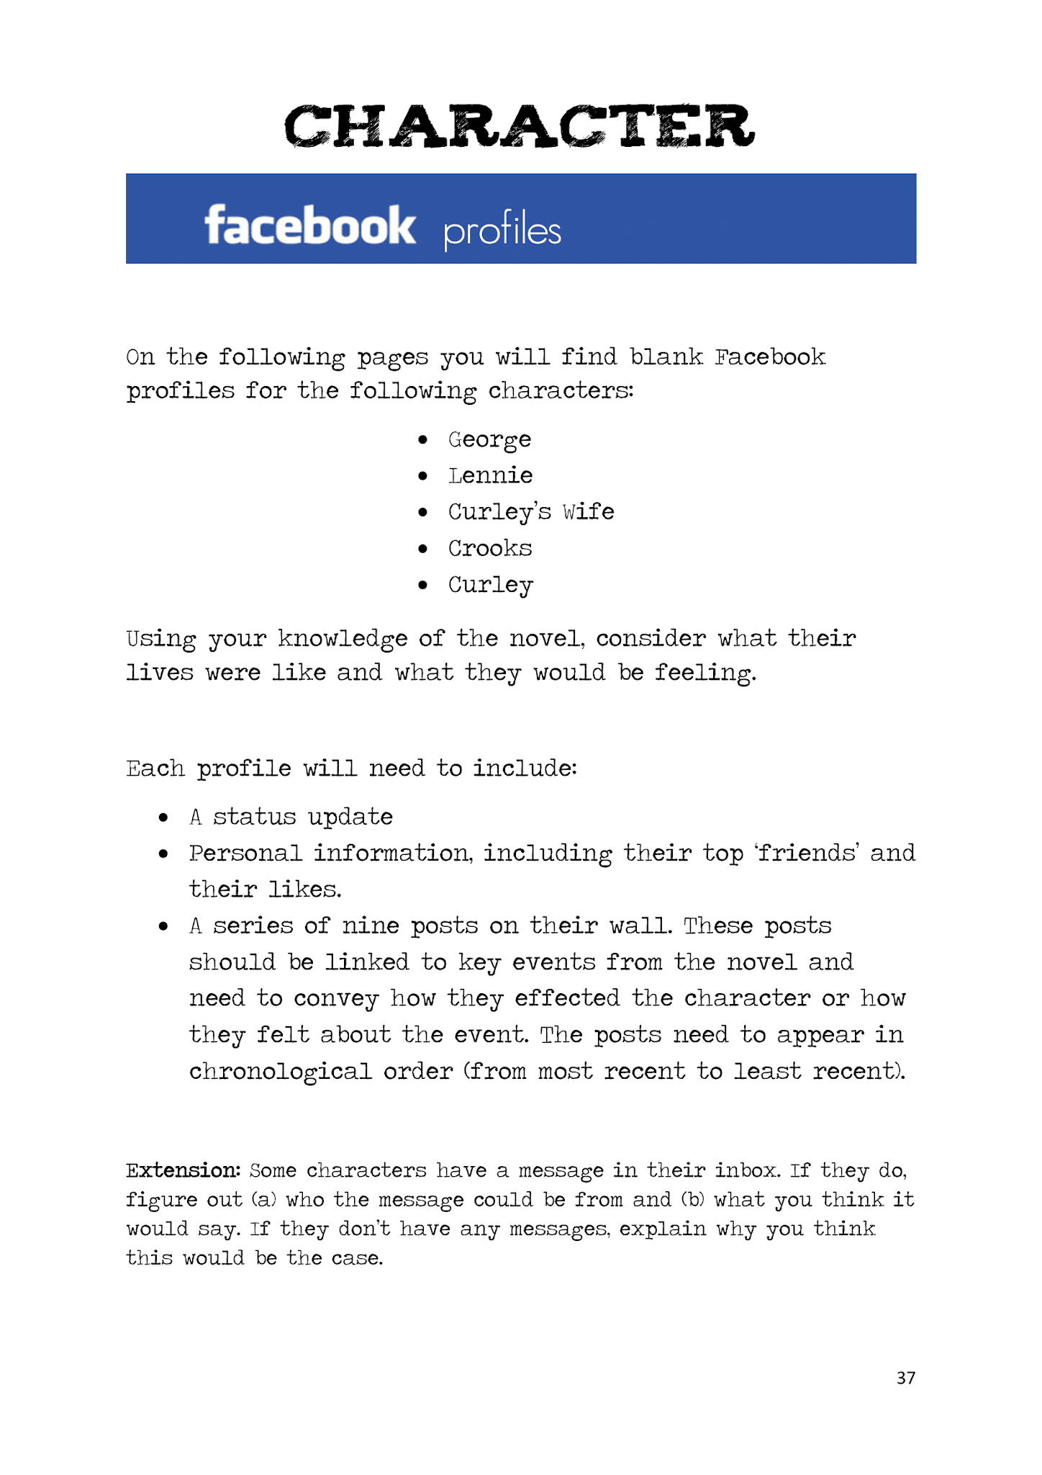

Having a hard time reading something?
Remember, you can zoom in on any part of this document. Just use the zoom button. The little dropdown arrow next to it has an option called “zoom in.”
Or you can click the zoom button and then click and drag the area you want to zoom in. That way, it’s zoomed to exactly the part you need! And you can always zoom out by choosing “fit” in the zoom dropdown menu.

Slide 2
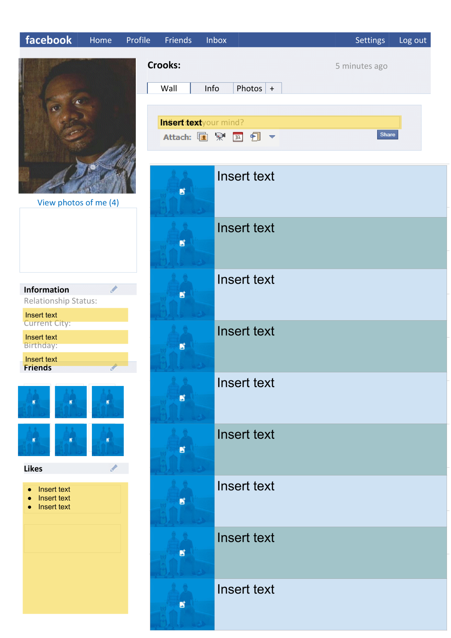
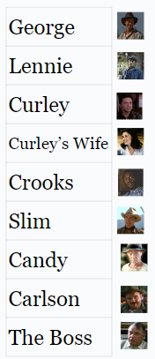
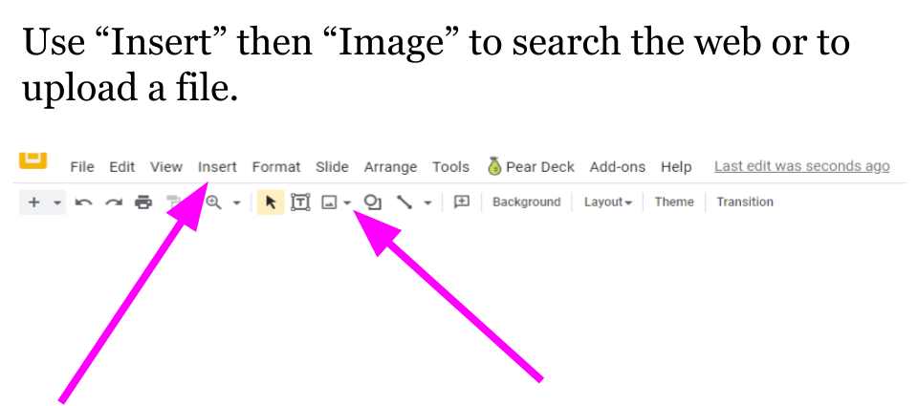
Helpful Hint
When searching for images, use search terms like “transparent” and “clipart.”

Slide 3
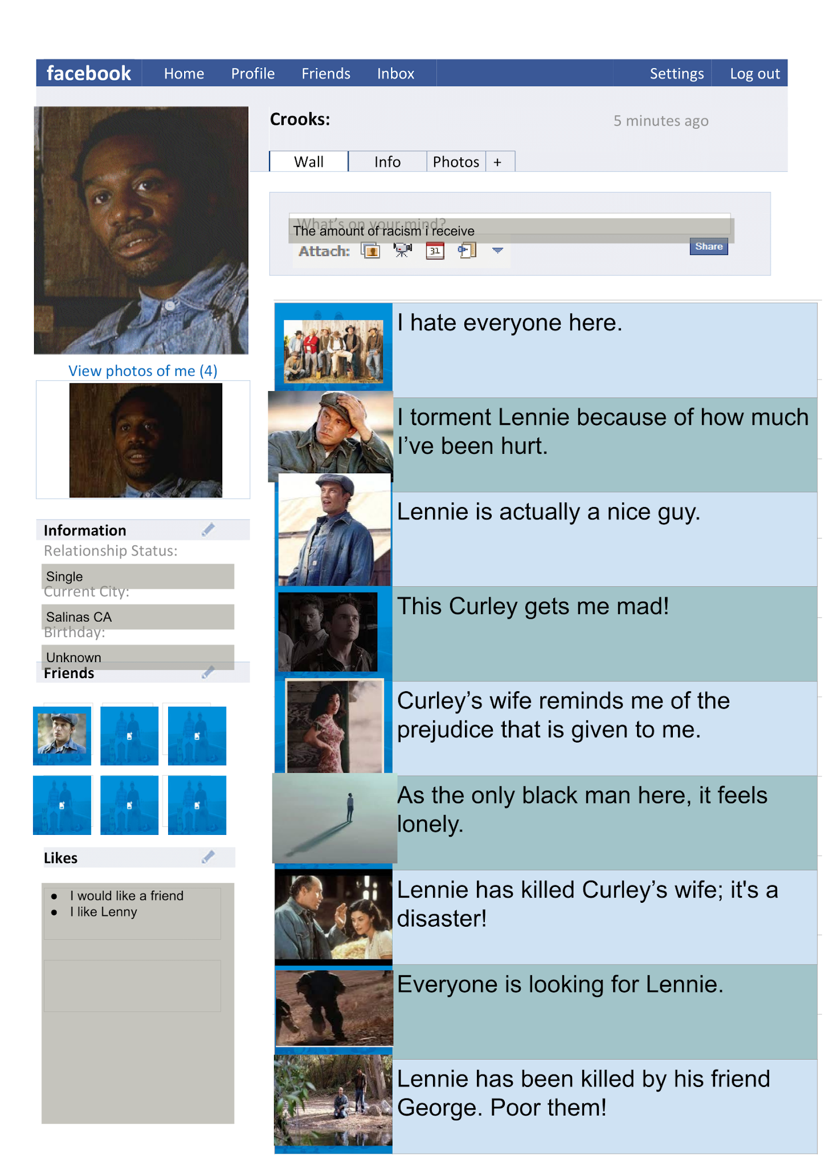
Example

Slide 4
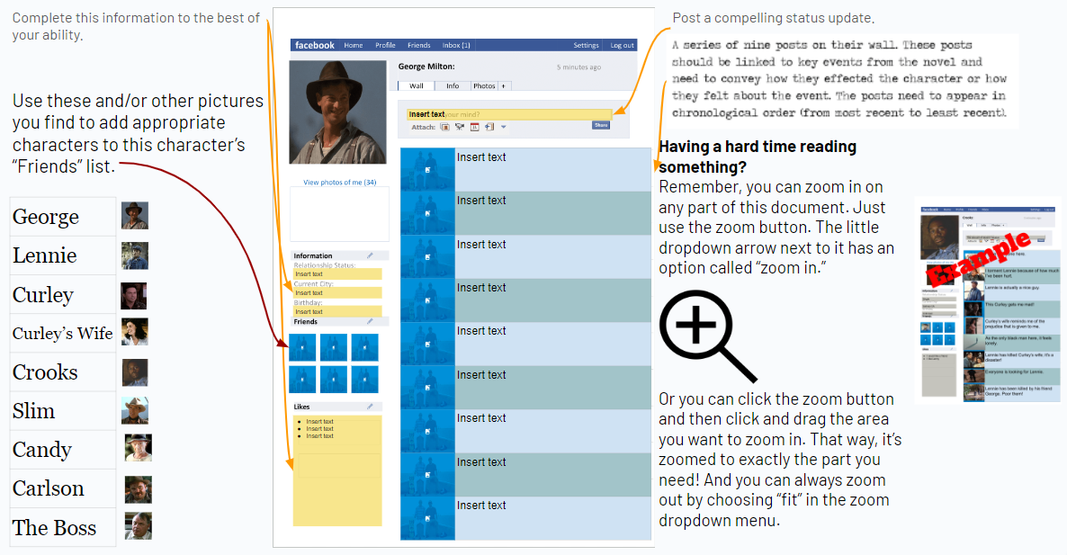

Slide 5
